Slide 1
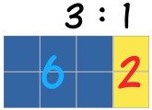

My Proportion Interactive Notebook
Name:
Class:
Teacher:
Term 2 Semester 1

Slide 2
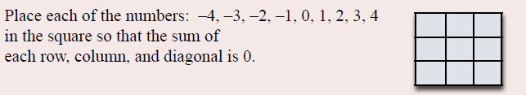
A Puzzle

Slide 3
24
7
30
Date
Rates
EQ – What are the different methods for answering rates questions?
What are rates?
A rate compares related quantities with different units. Rates are usually written with one quantity compared to a single unit of the other.
For example 50km per 1 hour (written like 50km/h)
Can you think of any other common rates? Do a quick write for 1 minute on all the rates you can think of.
How do use rates?
Given a rate is for 1 unit (50km per 1 hour), if we have more than 1 of those units we can simply multiply by how many we have.
For example, if we drive at 50km per 1 hour (50km/h) for 3 hours, we must have covered 150km (3 x 50).
Make sure the units are match the rate first!
Eg, if we drive at 50km/h for 30 minutes (half an hour), we must have covered 25km (50 x 0.5)

Slide 4
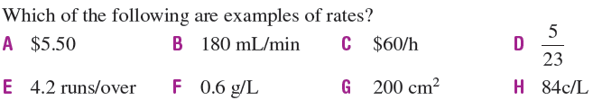
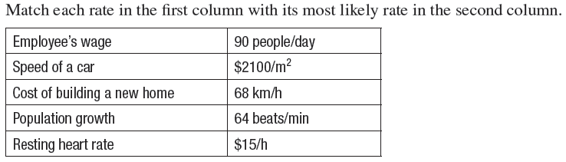
Let’s try some together
From the examples above
(a) If an employee works for 5 hours, how much will they earn?
(b) How many times will a heart beat in 15 seconds?

Slide 5


Slide 6

Now your turn!
Turn to page 151 and have a go at Exercise 11.7

Slide 7
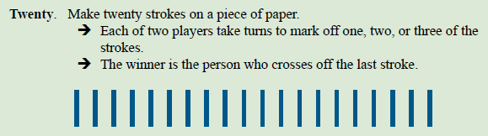
A Game

Slide 8

24
7
30
Date
Rates
EQ – What are the different methods for answering rates questions?
How do we find the rate?
To find the rate (eg 50km/h) we need to work out what one of that unit will be. To do this we need to divide both numbers by the same number, which is the number that converts the 2nd unit to 1. If the value is smaller than 1 (such as half an hour), you will need to multiply.
How do we compare rates?
If both rates are using the same units we can compare them.
For example if company A sells juice for $5 for 2L and company B sells it for $1.50 for 500mL, which is a better buy?
A $5 for 2L B $1.50 for 500ml
$2.50 per Litre $3 per Litre

Slide 9


Can you do these?

Slide 10


Slide 11

Task
Now complete Exercise 11.8 on Page 152

Slide 12
Notes Review
24, 7 ,30
Date
Title
Essential question
Notes complete
Notes complete with colour and diagrams
Questions completed
Contents page filed in
Formula page filled in

Slide 13
Homework
Review your notes and write a summary answering the essential question.

